Slide 1


Slide 2
Democracy has directly originated from the French democratic, but its real origin is Greek. In Greek there are two words—demos and kratos. The former means people while the latter rule and what we mean by democracy in English is rule of the people.

Slide 3
Definitions of Democracy:
According to Bryce, “Democracy is that form of Government in which the ruling power of a state is legally vested, not in any particular class or classes but in the members of the community as a whole”.
Prof. Seeley says, “Democracy is a government in which everybody has a share”.
According to Dicey, “Democracy is a form of government in which the governing body is a comparatively large fraction of the entire nation”.

Slide 4
Definitions of Democracy:
According to Gettell, “Democracy is that form of government in which the mass of the population possesses the right to share in the exercise of sovereign power”
In the words of President Abraham Lincoln, it is a government of the people, by the people and for the people.

Slide 5
Explanation of the Definition:
1. Democracy is a form of government in which people’s participation is of primary importance.
2. People may participate either directly or indirectly.
3. It is a form of government in which people have equal opportunity and this type of government is based on individual merit and no place of hereditary privilege is to be found in democracy.
4. Distribution of opportunities is adopted for reduction or removal of inequalities.
5. Democracy recognises that all the sections of the community will receive their due shares.
6. All the public offices and opportunities are opened to everyone and to fill the posts public examinations are held. There is also open competition on in which every eligible citizen has the right to participate.

Slide 6
7. It is a system of government which does not make any discrimination on the basis of caste, religion, sex, birth etc.
8. In democracy all must have the scope to govern or to be a member of government.
9. Rulers are to be accountable to the ruled and forms of accountability are many.
10. Rules are to be chosen by the ruled.
11. People shall have the right to decide who would rule them.

Slide 7
Kinds of Democracy
There are two types of democracy:
(1) Pure or Direct, and
(2) Indirect or Representative.

Slide 8
Direct Democracy:
When the people themselves directly express their will on public affairs, the type of government is called pure or direct democracy. The people formulate laws in a mass meeting. Hearnshaw has said, “A democratic form of government, in the strict sense of the term, is one in which the community as a whole, directly or immediately, without agents or representatives, performs the functions of sovereignty”.
Direct Democracy was established in ancient Greek city-states. In India, direct democracy was seen in Vajji Sangha during the Buddhist Periods. Today when large and complex societies have emerged and when area of is very extensive, direct democracy is impracticable. This system now prevails only four Cantons of Switzerland.

Slide 9
Representative or Indirect Democracy:
In a Representative or Indirect Democracy the will of the state is formulated and expressed not directly by the people themselves, but by their representatives to whom they delegate the power of deliberation and decision-making.
John Stuart Mill has said in this regard that “Indirect or representative democracy is one in which the whole people or some numerous portion of them exercise the governing power through deputies periodically elected by themselves”.
Another writer Bluntschli has said, “In the representative democracy the rule is that the people govern through its officials; while it legislates, and controls the administration through its representatives”.

Slide 10
This type of government was established in England in the seventeenth century. In France, it was established in 1830 and in Italy in 1948. In Germany it was established after the First World War according to Weimer Constitution. Again this system was established in West Germany after the Second World War. In India direct democracy was introduced in the Minto-Morley Reforms of 1909.
Today this system is seen in many countries like Japan, Sri Lanka, India, Canada, Australia, New Zealand, the United States of America, West Germany, Italy, France, Holland, Denmark, Sweden, Norway, Austria and Belgium.

Slide 11
Basic Principles or Requisites of Democracy:
(1) Liberty:
The main basis of democracy is liberty and equality. The people enjoy maximum liberty and equality because criticism of the people is not only tolerated in this system, but it is also encouraged. In Great Britain, the leader of the Opposition is paid by the government and he is consulted by the Prime Minister in national emergency.

Slide 12
(2) Equality:
Special emphasis is laid on equality in democracy and there is no disparity among the people on the basis of caste, creed, religion and position or status. For example, untouchability has been abolished in India.
Besides this, all are equal before law and there is no privileged class in India. It is essential to establish political and economic equality along with social equality. Thus, in order to establish political equality, all disparities on the basis of caste, religion, colour and sex have been removed in India and Adult Franchise has been introduced in order to give opportunity to all the citizens to contest election to Provincial Assemblies and Lok Sabha.

Slide 13
(3) Fraternity:
Democracy can become successful only in a peaceful atmosphere, otherwise democracy has to face many difficulties. For this purpose Jawaharlal Nehru placed an idea of Panch Sheel before the world in 1954. Our government and many other democratic governments of the world are making efforts to promote world peace. India was the President of the Non-Aligned Movement and propagating this policy.
(4) The people as ultimate source of sovereignty:
In a democracy, people are the ultimate source of sovereignty, and the government derives its power from them. For this purpose elections take place in democracies at certain intervals. In India and England, General Elections take place after every five years and in U.S.A. after every four years.

Slide 14
(5) Fundamental Rights to the People:
In a democracy people are given fundamental rights because in the absence of these rights the development of an individual is not possible. Fundamental rights have been granted to the people in their Constitutions in India, Japan, U.S A., France and Italy. In England the rights and freedom of the people are protected through the Rule of Law, Charters, Acts of Parliament, and Judicial Decisions given from time to time.
(6) Independence of Judiciary:
In a democracy, it is responsibility of the judiciary to protect the fundamental rights of the people. In our country the Supreme Court and the High Court’s protect the Constitution and the fundamental rights of the people. Wherever judiciary is not free, the protection of fundamental rights is not possible.

Slide 15
(7) The people are considered as an end and State as the means in a democracy:
This is one of the main characteristics of democracy that individual is a mean and the state is an end. It means that the state makes use of the individual for its own interest. In a dictatorship no attention is paid to the freedom of the individual.
(8) Welfare State:
Democracy is a welfare state and m it special attention is paid to the welfare of the people as a whole and not to a particular class.

Slide 16
Conditions Necessary for the Success of Democracy
It can be successful only when following conditions are secured:
1. Democratic Society:
A democratic society is essential for the success of a democratic government. A democratic society is one which willingly accepts the values of liberty and equality. It is a society which is not characterised by a democratic thinking, no democracy can be successful. Without being supported by a democratic society, no democracy can successfully work

Slide 17
2. Economic Equality:
Economic equality in society can guarantee the success of democracy. Without economic democracy, political democracy remains true only on papers. People cannot be fed on votes, they need foods. They cannot live on mere slogans and populism. Economic equality involving equitable distribution of income and wealth and adequate opportunities for livelihood, is an essential condition for the success of democracy.
3. Educated and Enlightened Citizenship:
Democracy is a system which involves a continuous and active involvement of the people in the political process. Without popular and effective political participation, no democracy can be successful. For this purpose, it is essential that literacy should be widespread and people must be enlightened in respect of their rights, freedoms and duties as citizens of a democratic system.
No democracy can work successfully if its citizens are not prepared to sacrifice their individual interests for the sake of social good. Only educated and enlightened citizens are expected to realize and follow this vital condition for the success of democracy. Illiteracy and ignorance always hinder the success of democracy. The experience of our own country is before us.

Slide 18
4. Full respect for Fundamental Rights and Freedoms:
Democracy is regarded as the best form of government because it grants and guarantees fundamental human rights and freedoms to all its people. For this purpose it is essential for a democracy to take all steps which are necessary for granting, preserving and protecting the rights the people. For this purpose Rule of Law, Separation of Powers, Judicial Review, Decentralisation of Power and Independence of Judiciary have to be ensured.
5. Freedom of Press:
Without freedom of press, we cannot even imagine the working of a democratic government. Public opinion has to be the basis of all policies and decisions of a democratic government. The government must keep a continuous track of the demands of public opinion.
Press is the means for transmitting the public opinion to the government. Only a free press can perform this task in a desired manner. It is only through a free press that the people can exercise their right to freedom of speech and expression as well as their right to discuss and debate, criticize or support the policies and programmes of their government. Press is often described as the fourth essential but non-governmental institution of democracy.

Slide 19
6. Well Organised and Active Opposition:
In a democratic system political parties play a key role. These contest elections, wield power when voted to majority or act as opposition when not is majority. The majority party uses power of the government and the opposition parties criticise the policies of ruling party. Both have to play their respective roles and only then can a democracy work.
The ruling party can misuse its position by ignoring the interests of the minorities and the people in general. There is every need to keep it under supervision and check. It must be prevented from misusing its power in the name of majority. For this purpose the existence of a strong, well- organised and well-functioning opposition is always essential.
7. Mature Leadership:
The people are sovereign but they have to be led by their leaders and only then can they fruitfully exercise their power. In a democracy the leaders are in reality the policy-makers and the decision-makers. They can perform these tasks only when they are able, mature, honest and dedicated.

Slide 20
8. Spirit of Tolerance and Compromise:
In a democratic government no person, group or party can be permitted to act arbitrarily. No one should try to impose one’s will upon others and use power in an arbitrary way. This can be possible only when the people have a high sense of tolerance, accommodation and compromise.
The majority should not ignore the minority. It must respect the wishes of the minority. The minority should not act in a way as can create hindrances in the way of exercise of power by the majority. This can be secured only when all the people accept tolerance, accommodation, compromise, secularism and mutual give-and-take in national interest as their values.

Slide 21
9. Well organised and Powerful system of Local Government:
For a successful working of a democratic system one of the most essential conditions is the existence of a well organised and powerful system of local government. A local government is that through which the people of a local area meet their local needs and problems with the help of local resources and through a locally elected government.
It is as such a training school of democracy. Local government system constitutes the grass root level base of a democratic system. Just as no big building can be raised without broad and solid foundations, likewise no democratic government can be really organised and effectively run without the existence of a board, strong and efficient system of local government working at the foundation level.

Slide 22
10. Democratic Institutions:
Independence of judiciary, rule of law, decentralisation of powers, separation of powers, sound and independent election machinery, healthy education system, and liberalism in thought and actions are the other essential requirements for the success of a democratic system. All these features must be properly secured only then can a democracy be expected to work successfully.
At these are the essential conditions for the successful working of a democracy. These conditions can help a democracy to reduce its possible demerits as well as to let its merits help the people in developing their personalities and in enjoying their lives.

Slide 23
Direct Democracy:
In direct democracy all adult population, remaining present in the form of assembly, takes part in decision-making and exercise of power. It does not delegate its powers to any other person or representatives. Ancient Greek city-states had direct democracy. In modern times, only some cantons of Switzerland have such direct popular assembly, known as Landsgemiende.

Slide 24
Still some devices of direct democracy are available:
(1) Referendum, meaning referring some important issue, policy or decision to the people, such as, amendment of the constitution. Rendering opinion by the people can be (i) compulsory, or (ii) voluntary.

Slide 25
(2) Initiative implying that the people or a certain portion of the citizenry can take initiative to get certain law of its choice passed. They can send the proposal to the legislature which may enact it on usual lines.
3) Recall. By this device, the people of a constit­uency, by their majority can ask the legislature to send back their representative, and, thus, cancel his membership. Many states of the United States empower their people to do so.

Slide 26
(4) Plebiscite indicates that the people are directly consulted on questions of political importance

Slide 27
PROCEDURAL DEMOCRACY
Participatory democracy goes beyond the simple fact of voting, what it seeks is a high number of citizens to get involved in governmental and social tasks. In a certain sense, participatory democracy is also known as radical or direct democracy, distinguished by seeking a more active participation of the citizens in the legal and executive decisions.
Citizens should not be satisfied with the electoral process, but should instead be active subjects in society and in political life. This means that the individuals must demand the institution and state powers to be transparent, accountable and honest, and to serve the public interest besides

Slide 28
Procedural democracy is a democracy in which the people or citizens of the state have less influence than in traditional liberal democracies. This type of democracy is characterized by voters choosing to elect representatives in free elections. Procedural democracy assumes that the electoral process is at the core of the authority placed in elected officials and ensures that all procedures of elections are duly complied with (or at least appear so). It could be described as a republic (i.e., people voting for representatives) wherein only the basic structures and institutions are in place. Commonly, the previously elected representatives use electoral procedures to maintain themselves in power against the common wish of the people (to some varying extent), thus thwarting the establishment of a full-fledged democracy. Procedural democracy is quite different from substantive democracy, which is manifested by equal participation of all groups in society in the political process.

Slide 29
SUBSTANTIVE DEMOCRACY
Substantive democracy is a form of democracy in which the outcome of elections is representative of the people. In other words, substantive democracy is a form of democracy that functions in the interest of the governed.It is contrary to procedural democracy.This comes in contrast of procedural democracy.
Although a country may allow all citizens of age to vote, this characteristic does not necessarily qualify it as a substantive democracy.

Slide 30
The form of democracy termed substantive , corresponds to that which goes beyond the political sphere and extends to the social life. This form of government came to be a consequence of the challenges that procedural democracy was notable to deal with, which are the following; 1) capability of generating socio-economic equality, 2) promoting the participation of the greatest possible number of people in public questions, 3) creating mechanisms that make the governments work for people and not for their personal interest .

Slide 31
The main difference between the substantive and procedural democracy is that for substantive democracy material equality matters as much as formal equality, highlighting thus the relevance of social, economic and cultural rights. In addition, not only the rules of the game are the ones that matter, but all the elements involved in the democratic game must have access to an impartial and high quality education, universal health coverage among many other substantive valuable services

Slide 32
Those who defend substantive democracy advocate for the universality , protection and effectiveness of Social Rights and for the respect of autonomy and dignity of all humans. For a substantive democracy to exist, there must be a strong rule of law to promote and safeguard all the rights enshrined in the highest norms (such as the Constitution and the International Human Rights Treaties) and/or the principles from which these arise (such as moral principles or principles of justice).

Slide 33
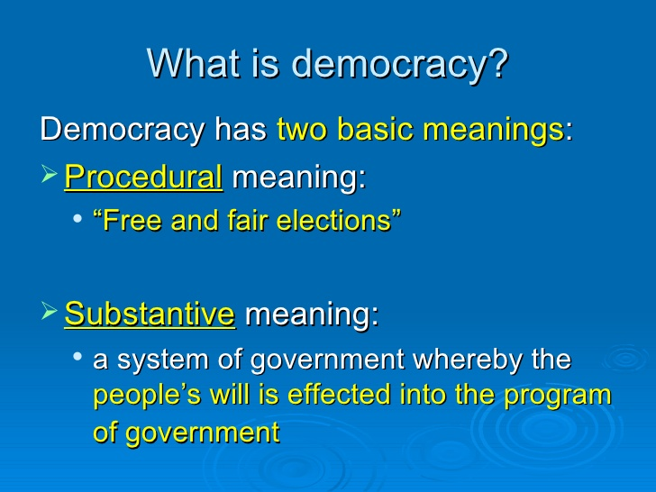

Slide 34
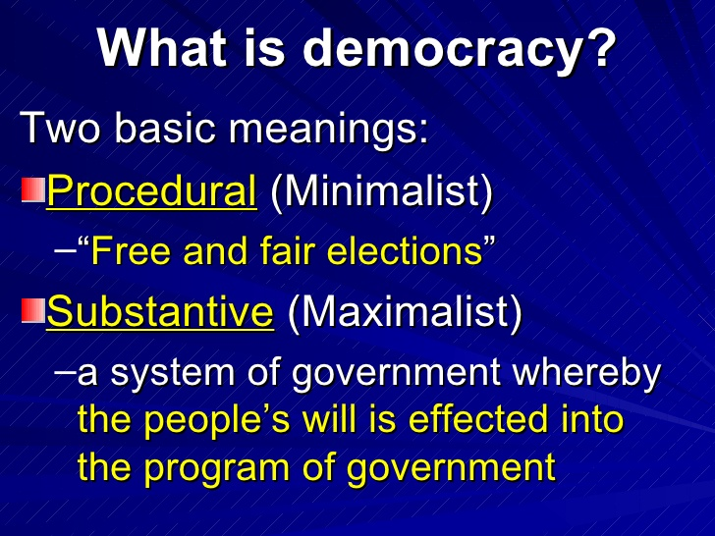

Slide 35
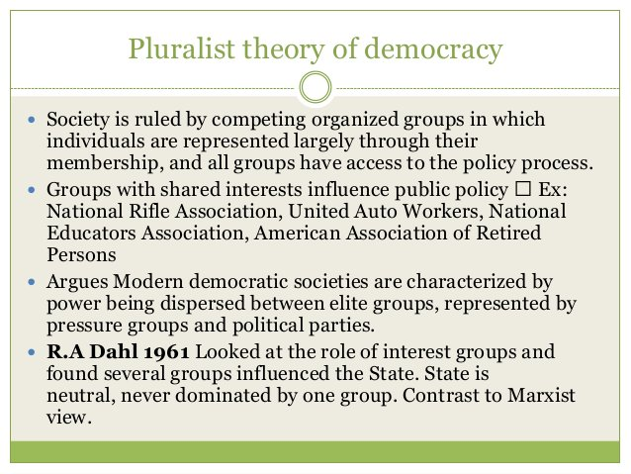

Slide 36
The Pluralist Theory of Democracy
Both Marxists and elitists hold that powers rest in the hands of a minority; the majority of the members of the society are excluded from the power structure. The pluralists, on the other hand, maintain that powers are not concentrated; these are dispersed. These are shared among all sections of people primarily through different organizations formed to articulate their interests. These groups and associations make regular and intense efforts to influence government policies and decisions. Some of them are overtly political while many others are potentially so. The latter, though apparently meant to serve some socio-cultural/economic purposes, are, when need arises, politically mobilised and activised.

Slide 37
A closer look at the dynamics of political and semi-political associations would reveal that these are dominated by a small group of leaders who tend to monopolize powers. As Lipset has observed in relation to trade unions, leadership tends to be oligarchic. This means that to a great extent the competition among different organizations for power-sharing is the competition among the leaders of these organizations. It is thus apparent that there is a great deal of overlapping between the Dahl-Schumpeter version of the elite theory, and the pluralist theory of democracy. In the ultimate analysis it is the elites who dominate political parties and interest groups, and who seem to be having close links with the ruling elites controlling the governmental structure.

Slide 38
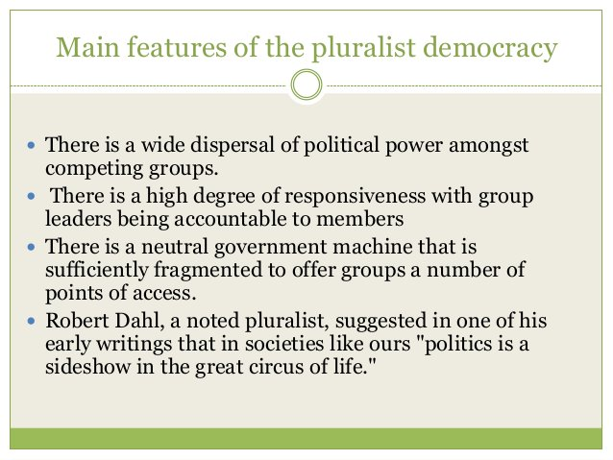

Slide 39
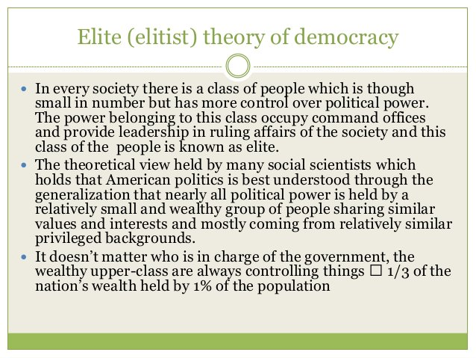

Slide 40
The elite theory states that the society is always ruled by a minority who are "superior" to others. The earlier elite theorists like Mosca and Pareto said that the elites were superior to others in quality. On the other hand, the later elite theorists like C. W. Mills and Floyd Hunter stated that the so-called superiority of elites was derived from their family and social backgrounds and the hierarchical organization of the society.

Slide 41
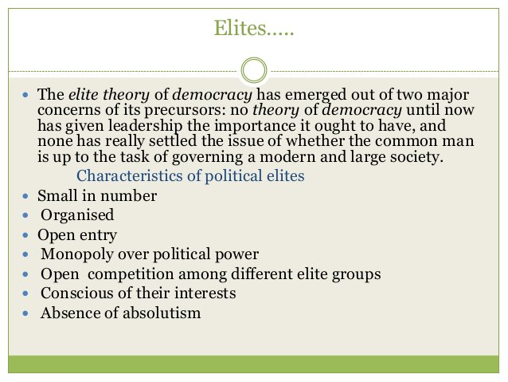

Slide 42
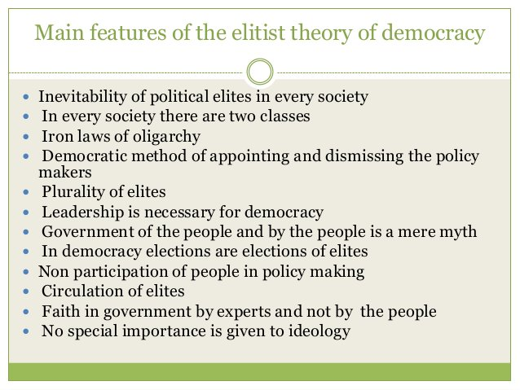

Slide 43
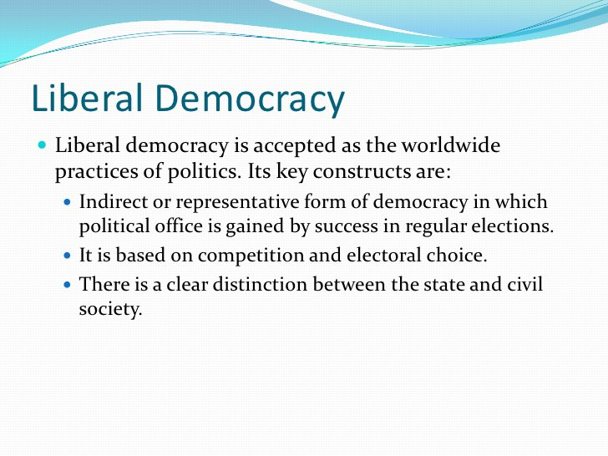

Slide 44
Liberal Democracy is the ideal and encompasses the following principles
Free, fair and regular elections
Freely competitive
Governments are continuously responsible
Constitutional citizens rights
Variety of beliefs tolerated
Peaceful transition of power
Rule of law
Limited government

Slide 45
Because Liberal Democracy is the ideal, there are different forms/degrees of it that can be seen in practice. These include REPRESENTATIVE DEMOCRACY when people hand over power to those elected - passing responsibility and putting distance between the ground/grassroots and decision makers. In the case of the UK this is seen in our PARLIAMENTARY DEMOCRACY where decisions are made on our behalf by parliament who are elected every 4 years.

Slide 46
.
MARXIST THEORY OF DEMOCRACY
Marxists, in principle, do not oppose democracy. On the other hand, they claim that their "democracy" is genuine whereas the bourgeois democracy is 'fake' and a 'sham'.
Marxists do not regard democracy as a political system. They view it as a system of values and a form of society. In the latter sense democracy does not have a final point of achievement. It is' a continuously growing process. Thus democracy goes on struggling to go beyond itself, in the process retaining its essence and improvising it further

Slide 47
As a political system, democracy is a class organism. It is meant to serve the interests of a particular class. Lenin distinguishes working class democracy from bourgeois democracy. Marxists reject the legitimacy of elections in bourgeois democracies. They argue that political parties in bourgeois states hardly differ from one another in respect of ideology. The ideologies of all of them are designed to buttress the interests of rich people. As a result, the poor people of capitalist countries have little choice. Whichever party they vote for would help the rich against them

Slide 48
Marxists further argue that in bourgeois democracies justice is very expensive. It is only the rich who can get judgments in their favor. They gave the money to buy justice. By money power and political influence they can close the eyes of the court to their crimes and other misdeeds. The poor, even if innocent, would be punished by courts. They have little leverage vis-a-vis the judiciary. The judiciary, it is contended, is not impartial. It has got a class character. It is manned by the representatives of the rich class and, no wonder, derives its interests.

Slide 49
Marxist Theory of Democracy
The Marxist theory views the democracy in the social context of class analysis during the era of industrial revolution. Society was divided into two classes viz: capitalists or owners of the property are called as ‘bourgeois’ and the working class is called as ‘proletariat’. The Marxist theory of Democracy held the political position to always challenge the dominance of capitalists and against the exploitations of working class. The Marxist theory of democracy did not support electoral rights, but strongly supported economic rights and the creation of ‘socialist democracy’.

Slide 50
The Marxist theory of Democracy favoured the collapse of capitalism and calls for the revolutionary transformation of the society. It believes that political power is possible only through the ideals of ‘socialism’; and is based on the equal distribution of economic power against the unequal wealth and ownership of production. The Marxists democrats and socialists believe in the removal of class differences and privileges are the necessary step to freedom, equal status and democracy.

Slide 51
